Slide 1







Insurance Practitioner Apprenticeship
Supervisor’s Induction
Notes:
NG

Slide 2







Agenda
10.30 - Welcome / CPD
10.35 - Overview of Apprenticeship
  Syllabus
  Academic Calendar
  Timetable of Lectures
  Examinations/Assessments
Q&A
10.55 - WBL Case Studies/Tasks
11.05 A Supervisor’s Perspective

Slide 3
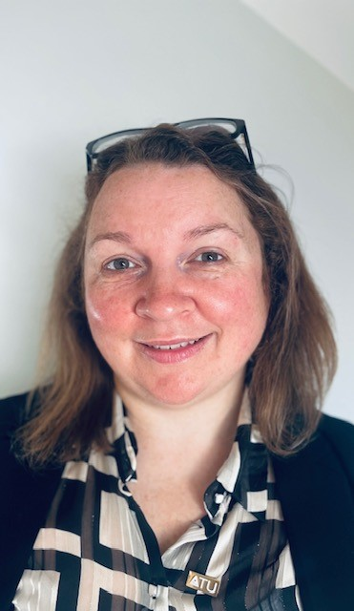
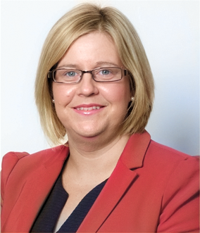
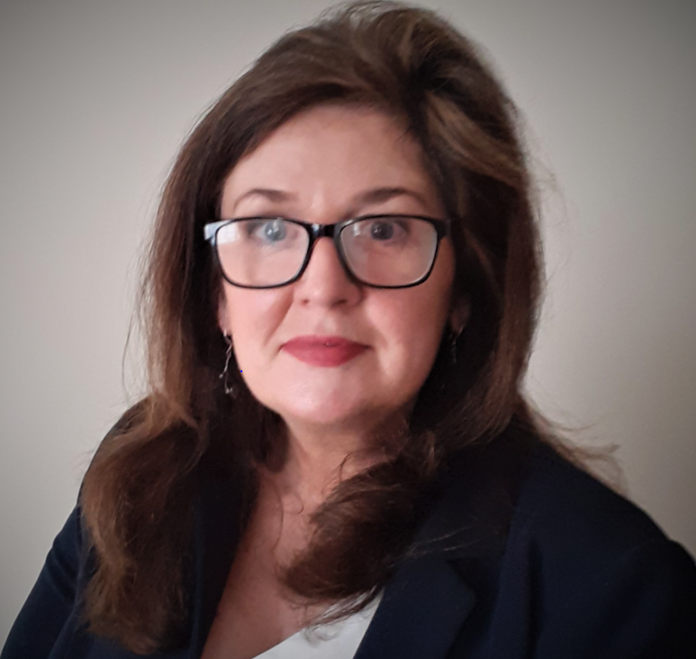

Meet the Team
Rebecca Gillen
Apprenticeship Manager
Insurance Practitioner
Apprenticeships
ATU Sligo
T: (071) 9305877
E: Rebecca.gillen@atu.ie
Anne McGlynn
Curriculum Manager
T: 353 87 9180865
E: amcglynn@iii.ie
Paula Hodson
Deputy CEO
Insurance Institute
E: phodson@iii.ie
Naomi Gaffney
Client Support Manager
Insurance Institute
T: (01) 6456629
E: ngaffney@iii.ie
E: apprenticeship@iii.ie

Slide 4
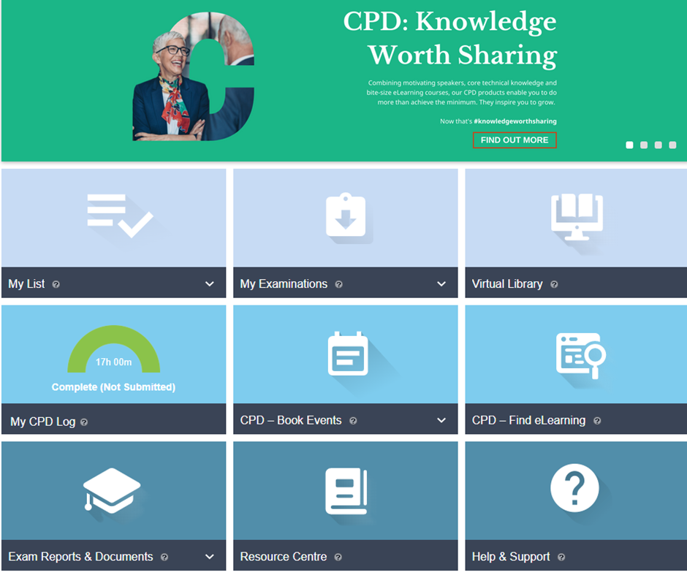
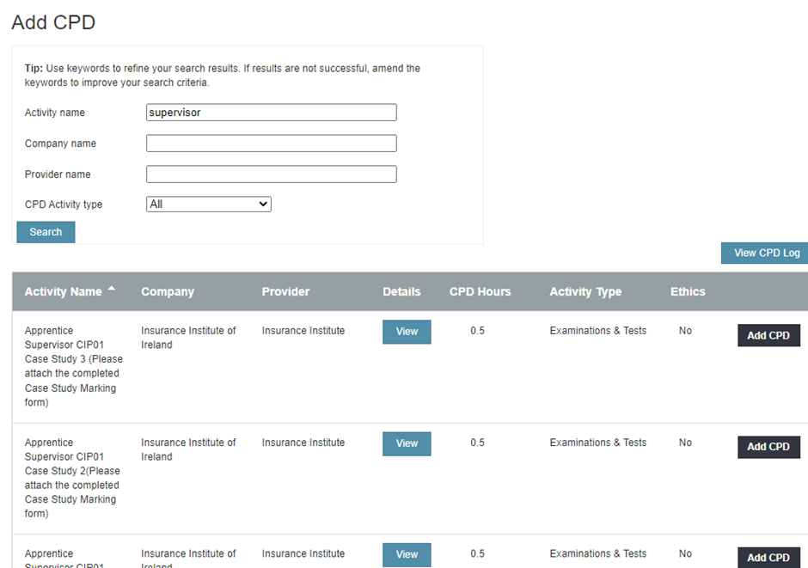

CPD
A maximum of 7.5 hours CPD per annum can be awarded to qualified supervisors for marking case study assignments.
If a supervisor has multiple apprentices, they can claim hours per apprentice for the correction of work.
In respect of APA/ CIP/ QFA/ ACII / FCII holders and Grandfathered persons, this breaks down as follows:
1. Up to max of 2.5 hours per semester (there are 3 semesters, i.e. Sept – Jan, Feb – May, June – Aug) or 30 mins per case study.
2. A member can add the CPD hours to their own CPD portfolio as the Institute has set up the events on Connect. A member can add a max of 15 such events to their CPD portfolios.
3. When adding the above named events, they must attach the completed evidence form (case study marking form, in pdf format)
4. Again, regardless of the number of apprentices a Supervisor has only a maximum claim of 7.5 hours can be allocated in any one calendar year for their Apprentice supervision work.
Choose the case study you have marked and add this to your CPD profile, please include the date as the due date of the case study.
Please upload the relevant sign off sheet of each case study as evidence, this must be a pdf document.
However, regardless of the number of apprentices a supervisor has only a maximum of 7.5 hours can be allocated in any one calendar year for apprenticeship supervision work.

Slide 5
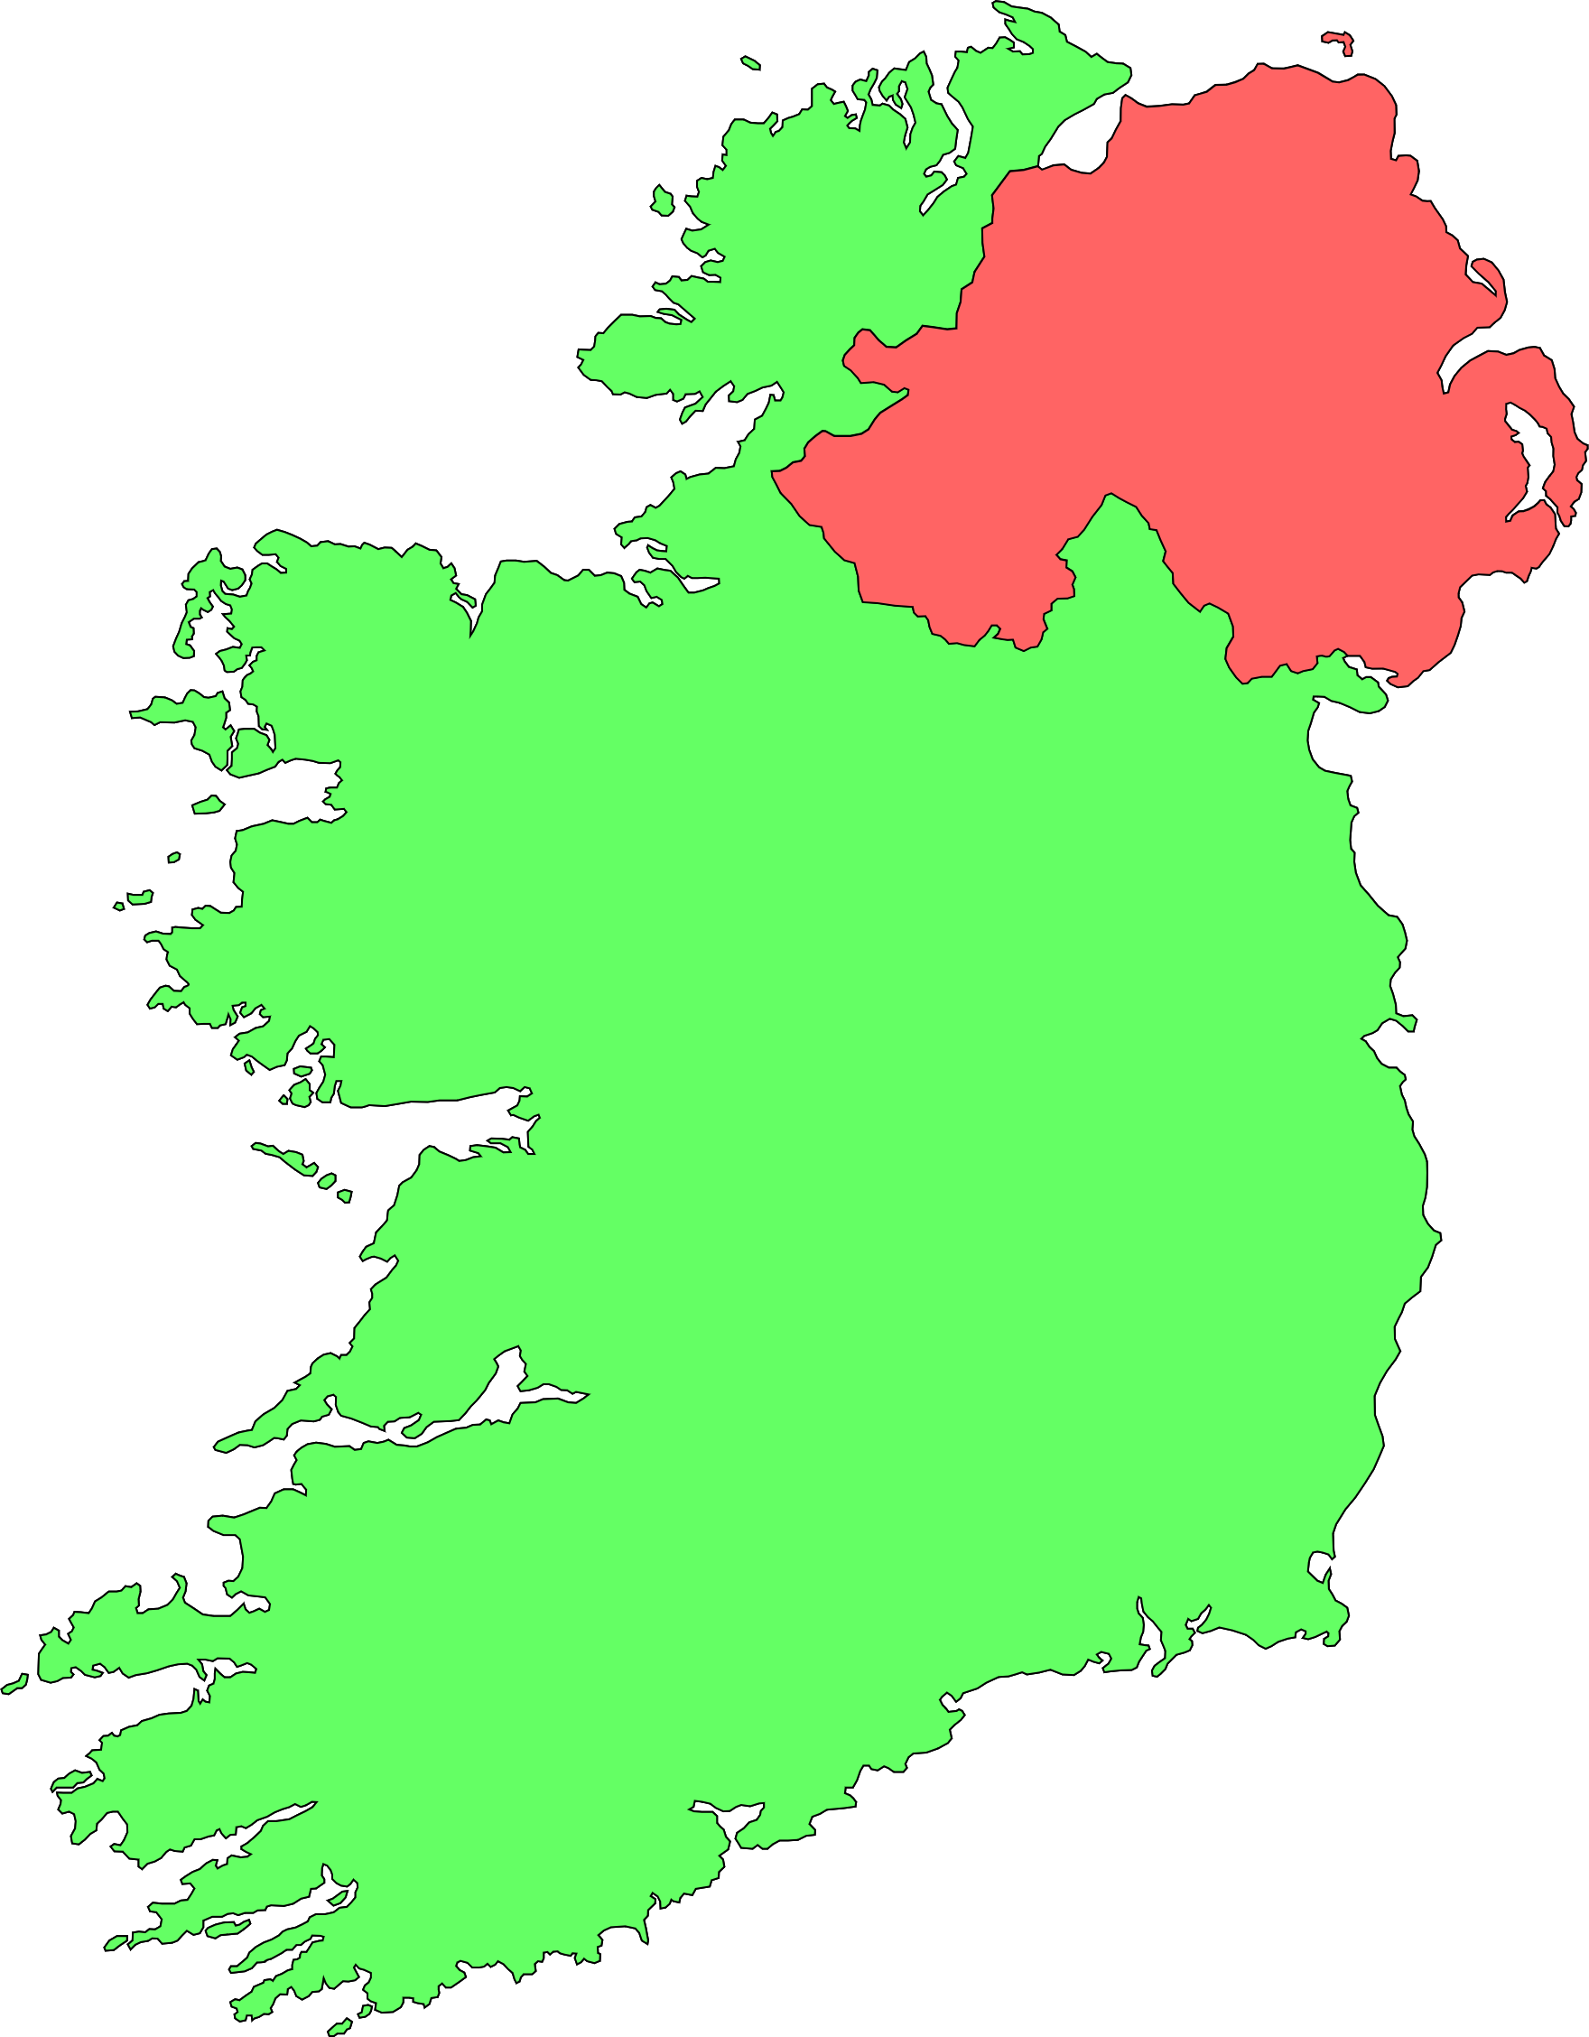
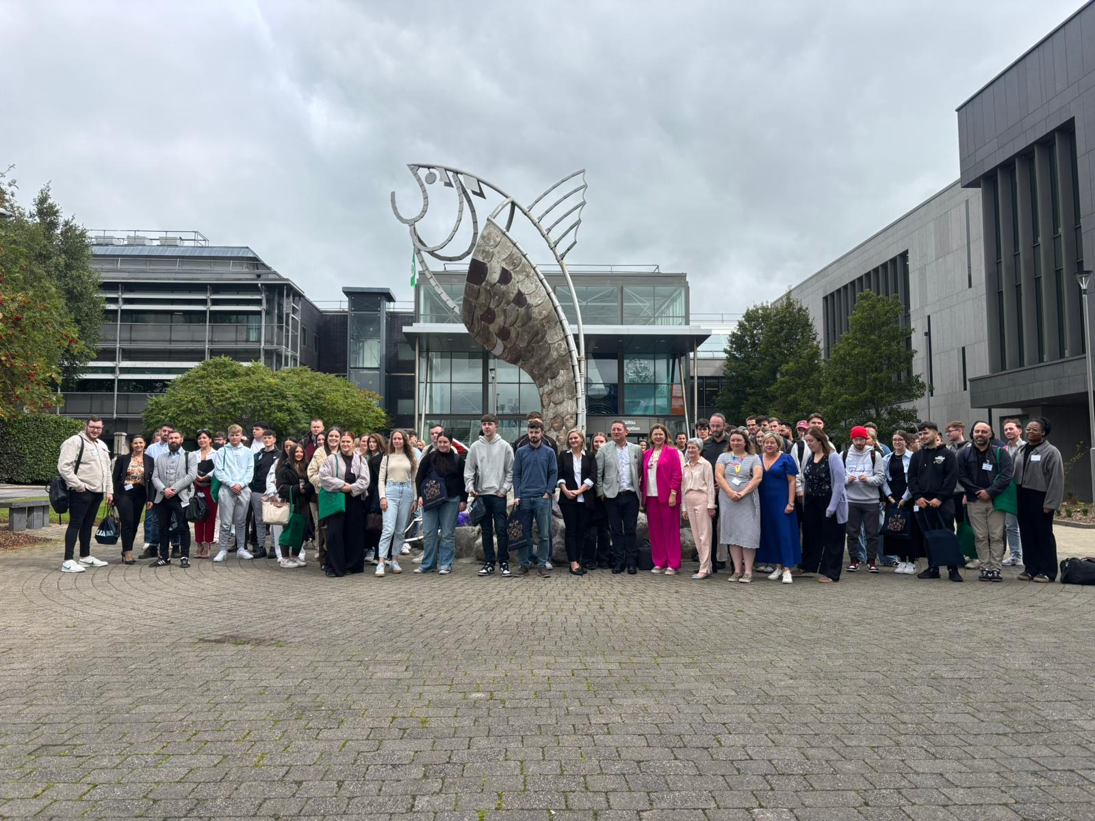
2025 Intake
93*
Apprentices’ country wide
* Final numbers still to be confirmed

Slide 6

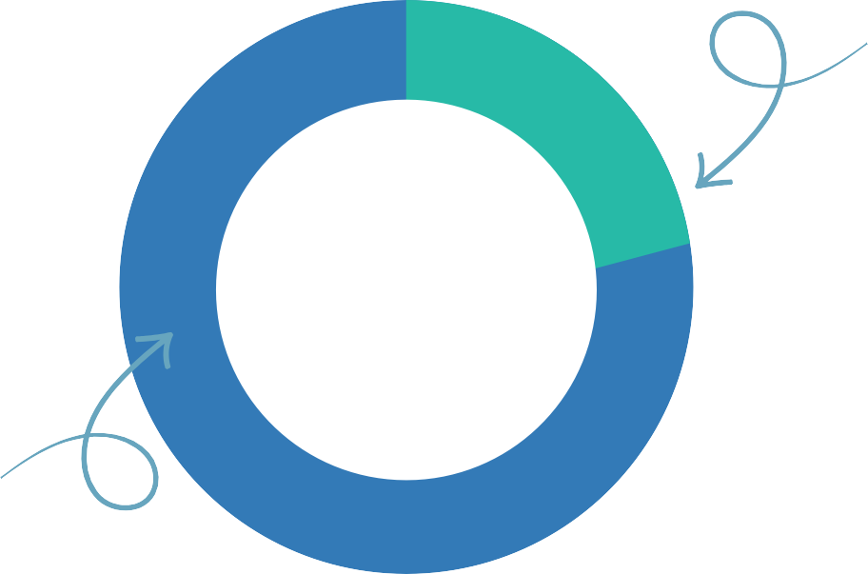

Insurance Practitioner Apprenticeship
18 57
Our 10th Intake - A Snapshot of 2025
17 Life Companies
42
Companies
Taking Part
268
25 General Companies
Total Number of Graduates to date
44 Male
23 on the Life Stream
Youngest Age
Eldest Age
93
Gender
Balance
93
Apprentices
Registered
70 on the General Stream
49 Female
Notes:
NG

Slide 7
Rebecca Gillen, Apprenticeship Manager, ATU Sligo
Introduction to Apprenticeship Manager
Progress Reports

Slide 8
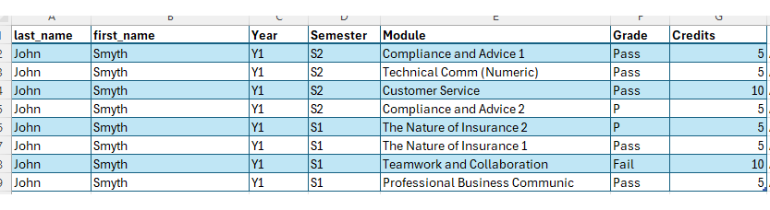

An apprentice cannot progress from 1st year to 2nd year if they have more than 10 failed credits. An apprentice cannot enter their 3rd and their final year if they have failed more than 10 credits or have an outstanding failed module from 1st year.

Slide 9
A Typical Week for an Apprentice

Slide 10

BA (Hons) in Insurance Practice
Academic Learning via ATU Sligo involving 3 streamed lectures 2.5 hours each in a quiet area in the office with access to a PC/Laptop
Working in the team on the job
Complete Case 5 studies for CIP-01/QFA life over the 13 week semester Complete WBL tasks &
diary entry
4 days a week
Semester 1
1 day per week
Summer Semester
June - August
a half day release
Become familiar with work practice tasks
Notes:
NG

Slide 11
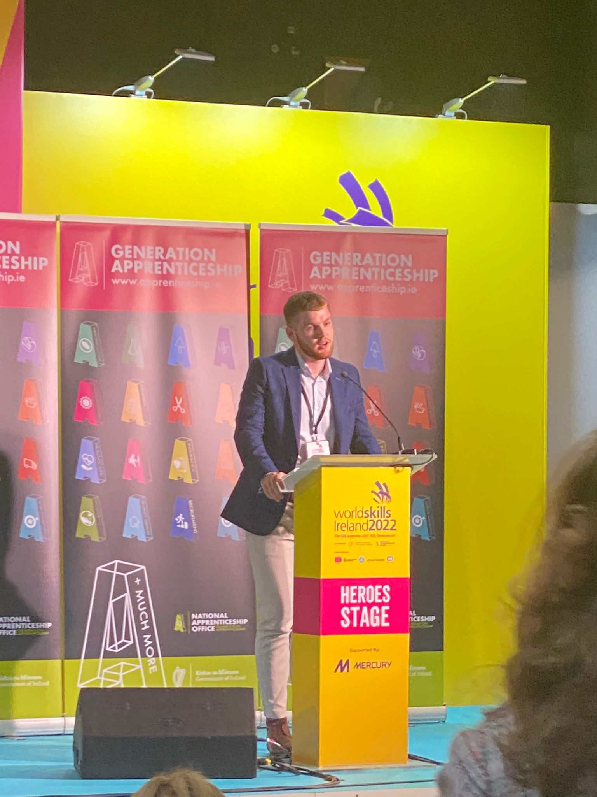
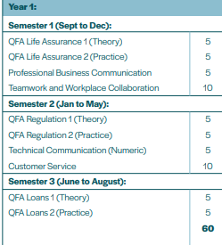
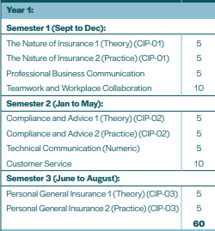
The Syllabus Life/General
REVENUE

Slide 12

Syllabus
3 Semesters per year
Year 2
Credits
Assessment Method & Timetable
Semester 4
Commercial General Insurance (Theory)
Commercial General Insurance (Practice)
OR QFA Pensions
Introduction to Management
Omni-Channel Marketing and Sales
5
5
January Exam
Continuous Assessment
5
10
Continuous Assessment Continuous Assessment
Semester 5
Practice of Claims and Loss Adjusting (Theory & Practice) 5
OR Practice of General Insurance Broking (Theory & Practice) 5
OR Practice of Risk Control and Underwriting (Theory & Practice) 5
OR QFA Investment
Technology Trends in Insurance
Negotiation in Practice
May Exam &Continuous Assessment May Exam & Continuous Assessment
Certificate in
Insurance Practice
(CIP)
5
10
Assessment & May Exam Continuous Assessment
Semester 6
Practice of Claims and Loss Adjusting (Theory & Practice)
OR Practice of General Insurance Broking (Theory & Practice)
OR Practice of Risk Control and Underwriting (Theory & Practice) 5
OR QFA Financial Advice
5
September Exam &Continuous Assessment
September Exam &Continuous Assessment
Notes:
NG

Slide 13
Syllabus
3 Semesters per year
Year 3
Credits
Assessment Method & Timetable
Semester 7
Capstone Project Preparation (Research Methods) 5
Innovation, Creativity and Critical thinking 10
Big Data/ Advanced Excel 10
Continuous Assessment
Continuous Assessment
Continuous Assessment
BA(Hons) in Insurance Practice (Apprenticeship)
Semester 8
Capstone Project Preparation (Dissertation)
Business Law for Insurance Practitioners
Financial Analysis & Interpretation
10
10
10
Continuous Assessment Assessment & May Exam Assessment & May Exam
Semester 9
Capstone Project/ Dissertation
5
Continuous Assessment
Notes:
NG

Slide 14


Module Credits
All modules, both work-based learning (WBL) and business modules, in this degree have academic credits attached to them.
There are 180 credits at the end of 3 years.
Each WBL module is allocated 5 ECTs. Typically, 1 ECTS = 20-25 hours of total student effort.
Some Business Modules (and all in Year 3) are 10 ECTS.
It is crucial to be aware of the level of work involved. required particularly in third year.

Slide 15

Every thing the apprentice needs is either in the guide (which all apprentices have received a copy of) or alternatively check out the Student Portal on the website.
A soft copy of the Handbook will be available on the Resource Centre shortly.

Slide 16
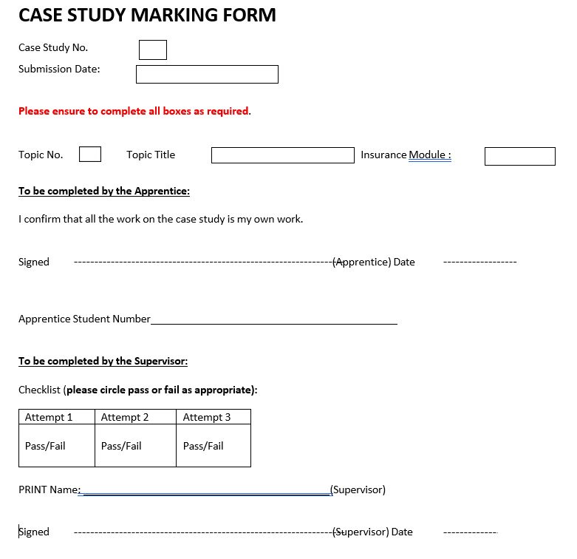
  You must complete one marking form per submission.
  ATU Sligo can be audited and must have CLEAR sign offs from supervisors.
  ATU Sligo will not accept pasted signatures.
  Easiest method is a short note stating case study number/diary month, etc.
  Work is acceptable. Ask your apprentice to provide you with a copy of the case study with their submission.
  A separate mail /sign off is required for each submission. This will discourage work being bulked together for approval.

Slide 17



The Role of a Supervisor

Slide 18

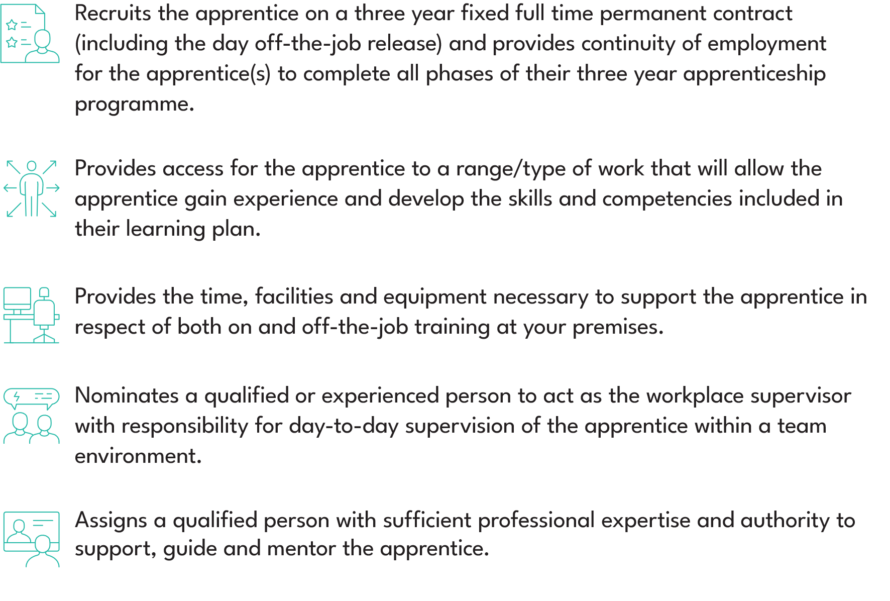
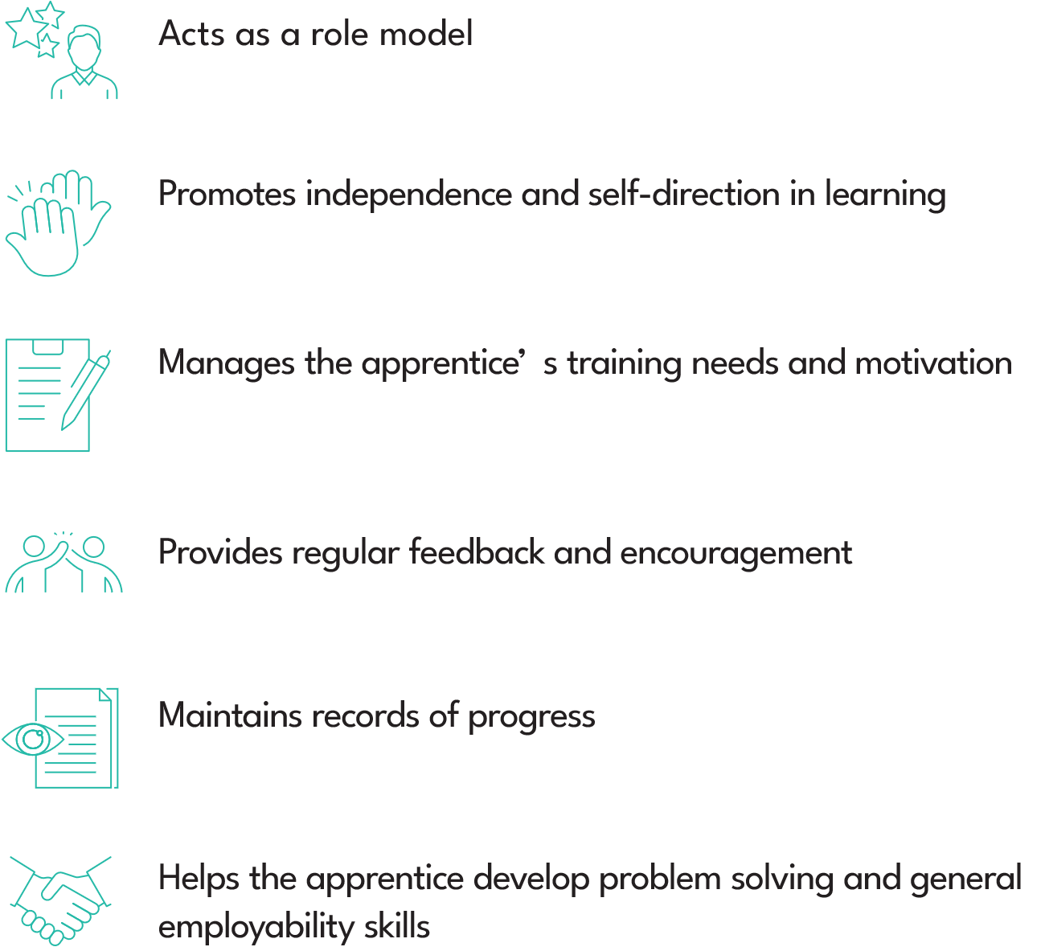
Duties & Responsibilities
2
Employer
Supervisor/Mentor
2
1
4
2
1
4
55
1
1
2
3
3
8
1
10
Supervisors can gain CPD for the correction of apprentices work based learning.
Notes:
NG

Slide 19
WBL Case Studies/Tasks
Best Practice – Examples

Slide 20
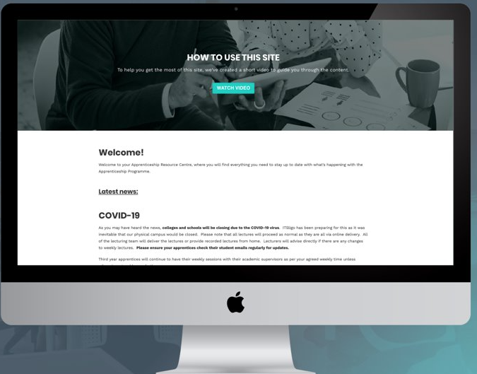
Supervisors’ Resource Centre
An email will be sent with a password after this session for access. The Resource Centre has copies of all relevant documentation
and information relating to the Insurance Practitioner Apprenticeship for both Life & Non Life Supervisors and Mentors. ​
The Resource Centre can be accessed through:
https://earnandlearn.ie/apprenticeships-employers​

Slide 21
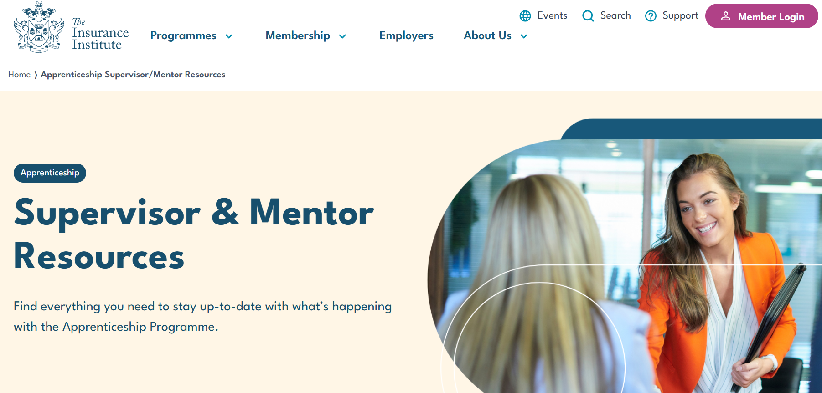
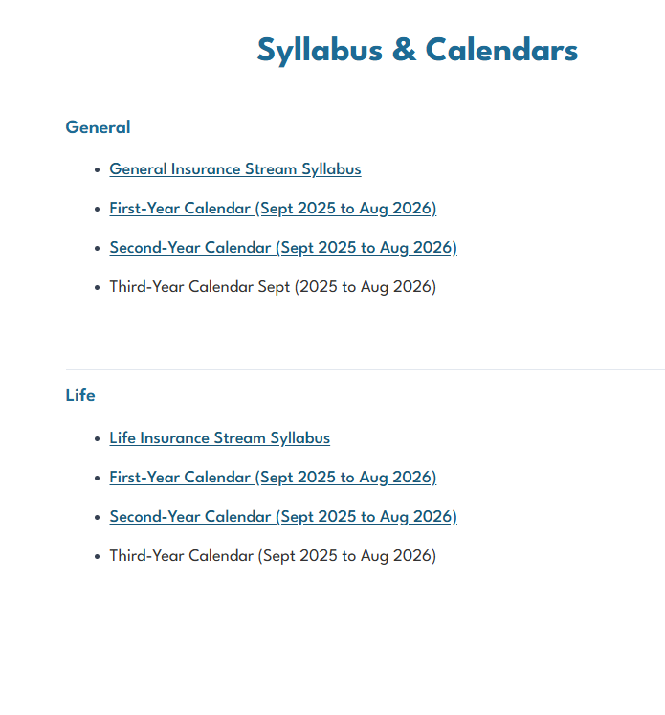
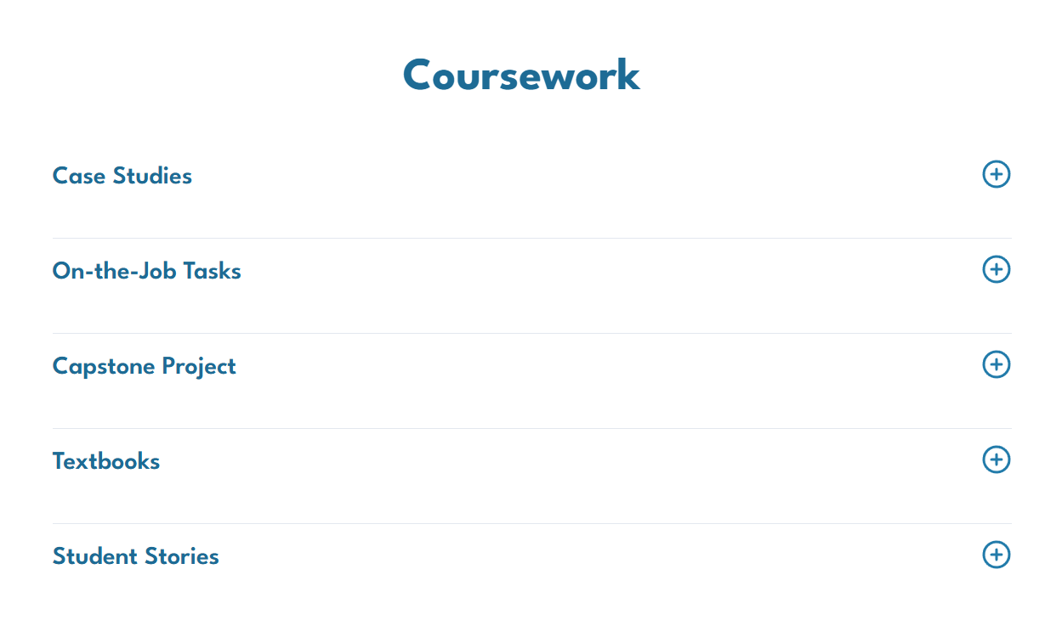

Slide 22
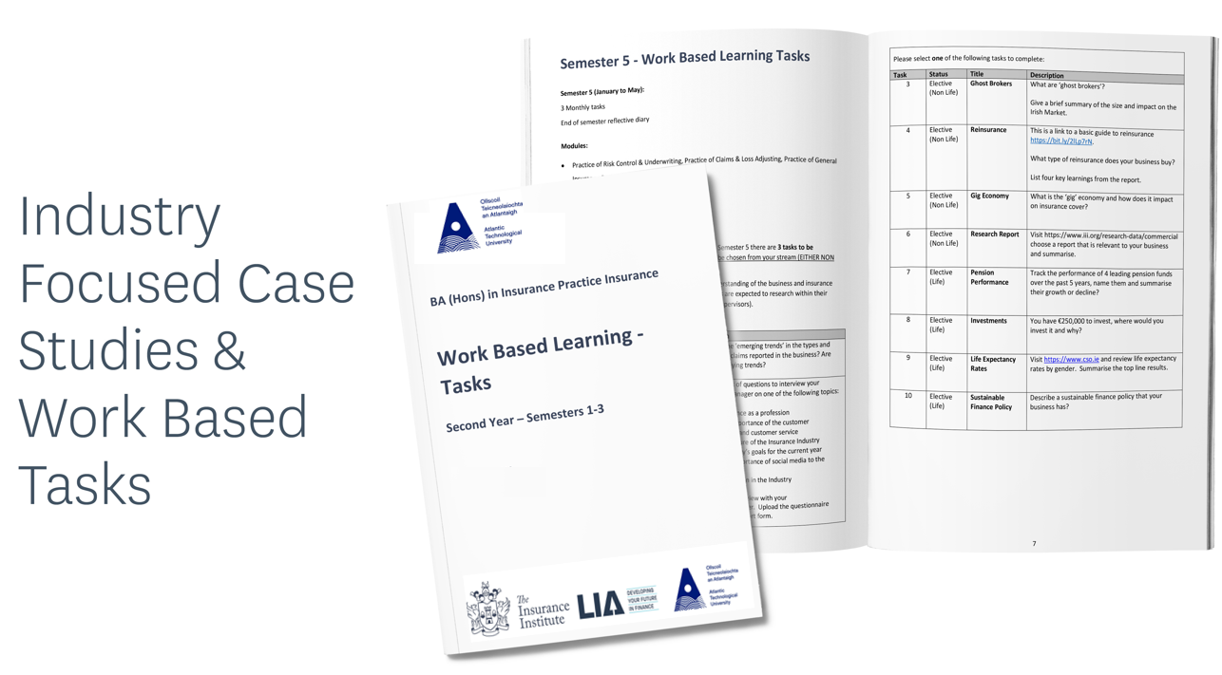

Slide 23
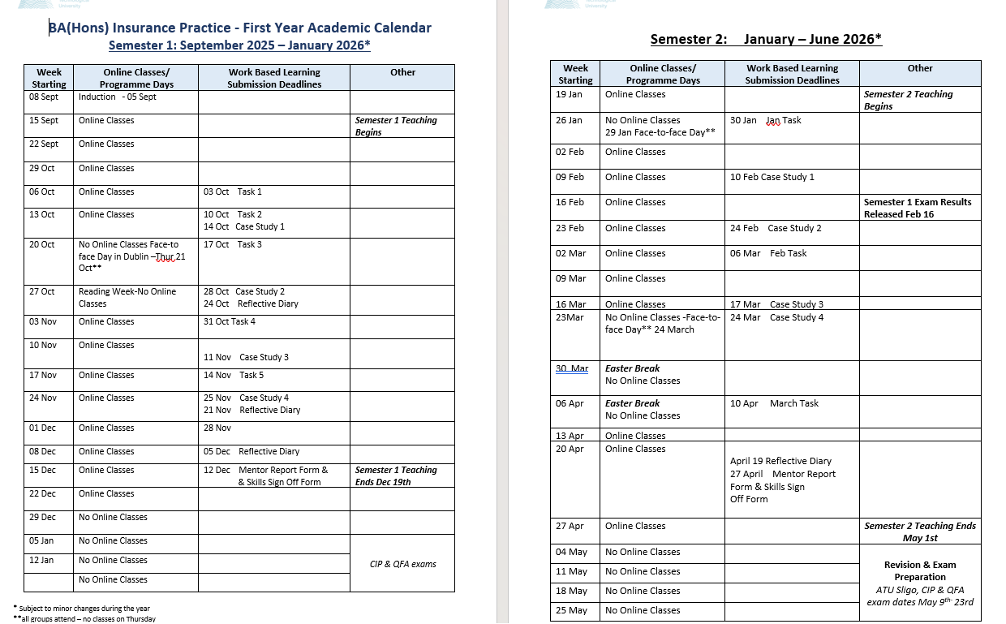
Apprentices have 4 face-to-face days.
Induction – Sept 5th, 2025
Tuesday Oct 21st, 2025
Thursday, Jan 29th, 2026
Tuesday, Mar 24th, 2026
Schedule Time to sign off case studies and work-based learning.
In first year, there are weekly tasks to ensure the apprentice engages with their supervisor.
THEY ARE MANDATORY

Slide 24
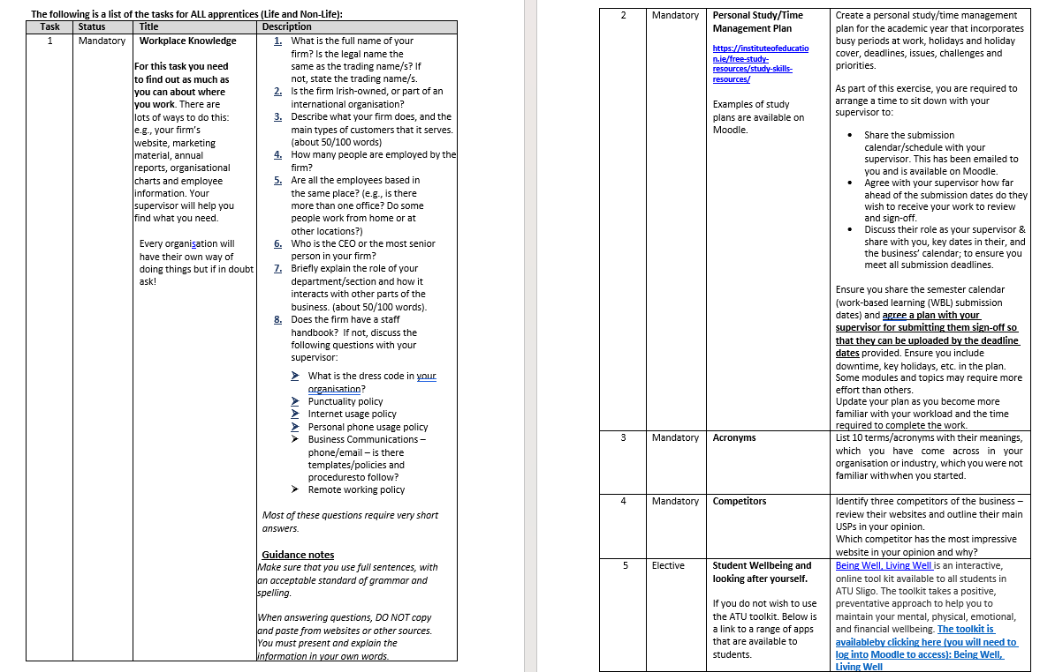
4 Mandatory and 1 Elective Task
End of Semester Reflective Diary

Slide 25

1. What is the full name of your firm? Is the legal name the same as the trading name/s? If not, state the trading name/s.
The full legal name is Aviva Life & Pensions Ireland DAC and Aviva Insurance Ireland DAC. The trading name is simply Aviva.
2. Is the firm Irish-owned, or part of an international organisation?
Aviva Ireland is part of the international Aviva Group, headquartered in London. It is not Irish-owned but operates as a major provider of insurance, pensions, and investment services in Ireland.
3. Describe what your firm does, and the main types of customers that it serves. (about 50/100 words)
Aviva is one of Ireland’s leading insurance and financial services providers. It offers motor, home, travel, health, life, pensions, and investment products. Its customers include individuals, families, and businesses seeking reliable protection and financial planning solutions. Aviva combines local expertise with the strength of a global brand, aiming to help customers manage risk and plan for a secure future.
4. How many people are employed by the firm?
Aviva employs approximately 1,450 people in Ireland (as of 2024).
5. Are all the employees based in the same place? (e.g., is there more than one office? Do some people work from home or at other locations?)
No. Aviva has offices in Dublin, Cork, and Galway. Many staff also work on a hybrid basis, splitting their time between the office and home.
6. Who is the CEO or the most senior person in your firm?
The CEO of Aviva Ireland is Declan O’Rourke (appointed 2022).
7. Briefly explain the role of your department/section and how it interacts with other parts of the business. (about 50/100 words).
I work in the Underwriting Department. Our role is to xxxxxxxxxxxxxxxxxxxxxxxxxxxx
8. Does the firm have a staff handbook? If not, discuss the following:
Yes, Aviva provides a comprehensive staff handbook covering workplace conduct, policies, and benefits.
Dress code: Smart casual, with flexibility depending on role and meetings.
Punctuality policy: Employees are expected to start work on time and attend meetings promptly.
Internet usage policy: Business use only; personal use is limited and must comply with IT security policies.
Personal phone usage: Allowed in moderation, provided it doesn’t interfere with work.
Business communications: Email and phone should follow professional standards. Templates and procedures are available for certain correspondence.
Remote working policy: Hybrid working is supported, with specific guidelines for availability, data protection, and security when working from home.

Slide 26
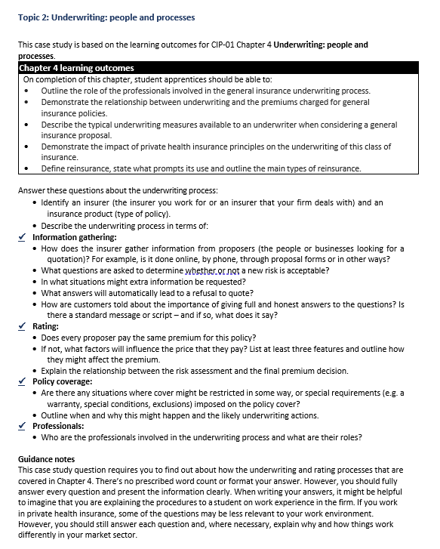
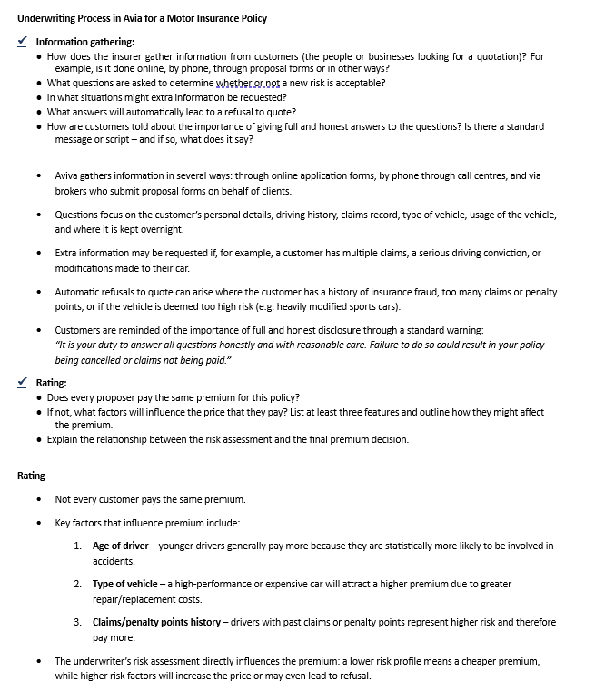

Slide 27
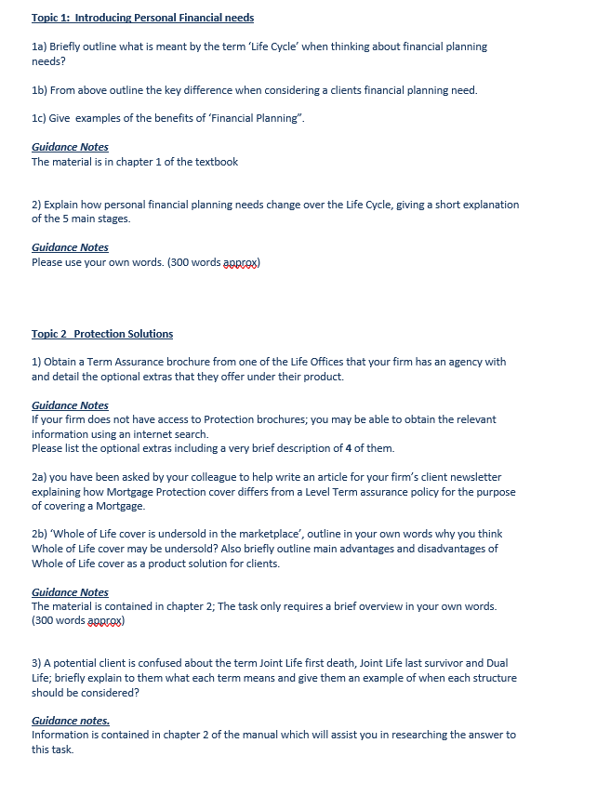
Case Study - Life

Slide 28
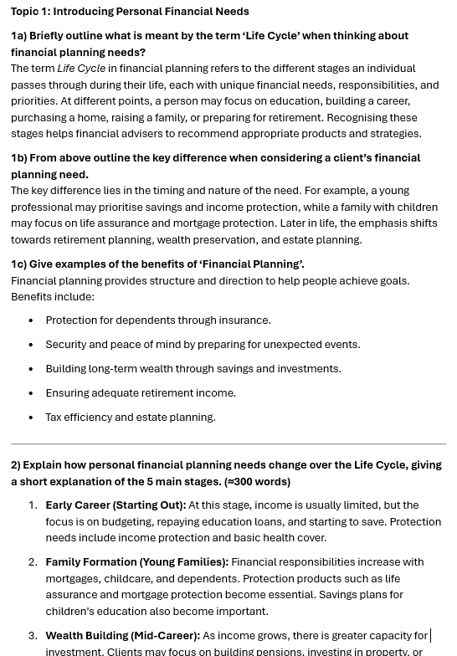
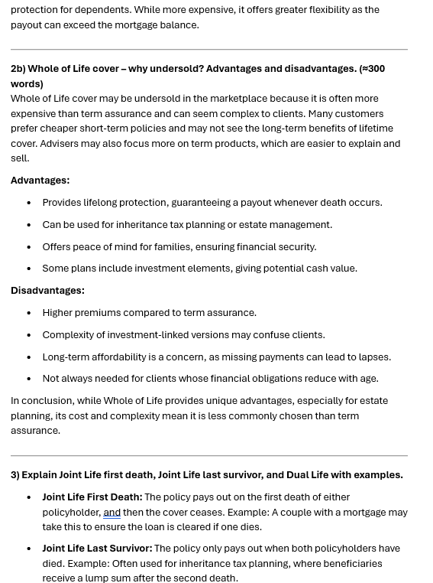
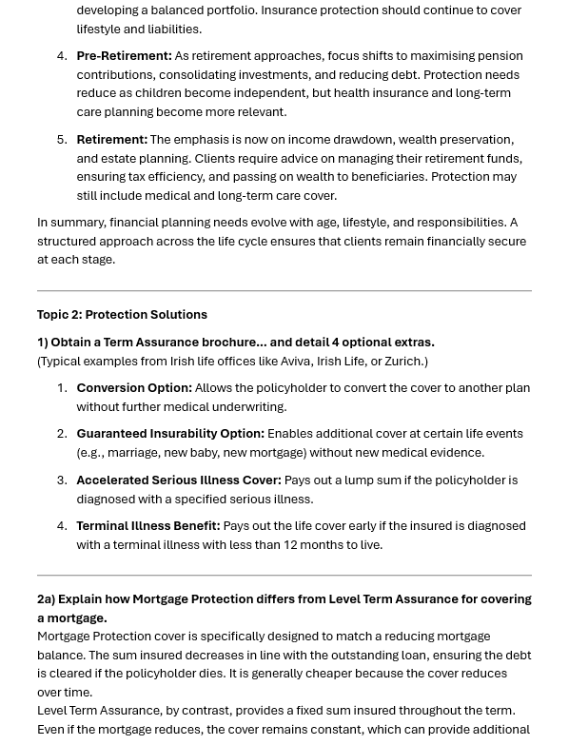


Slide 29
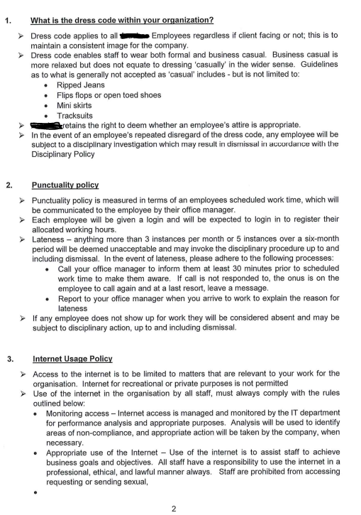
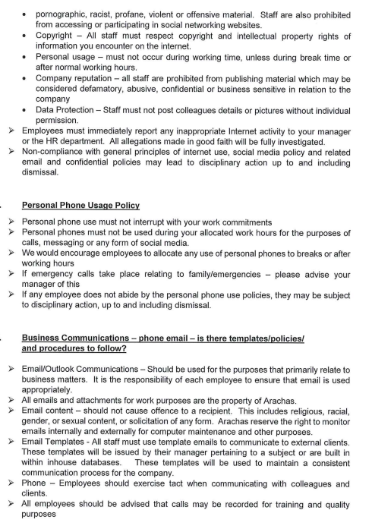
Examples: Task 1 – Business Etiquette
Example 1

Slide 30

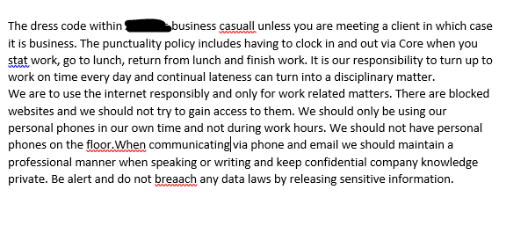
Example 2

Slide 31
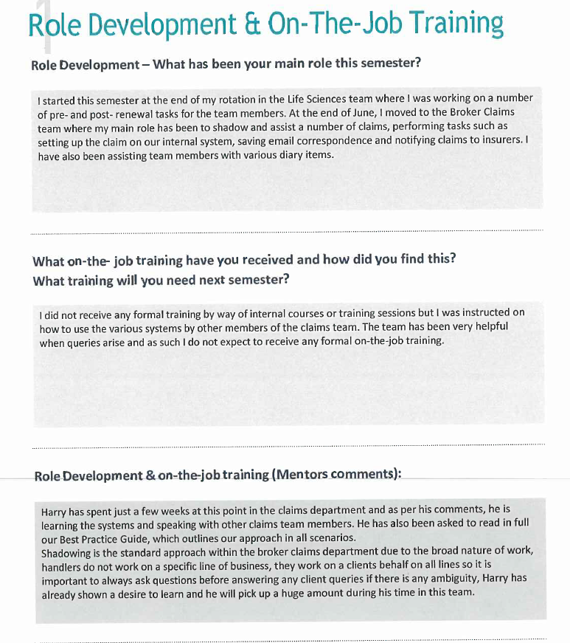

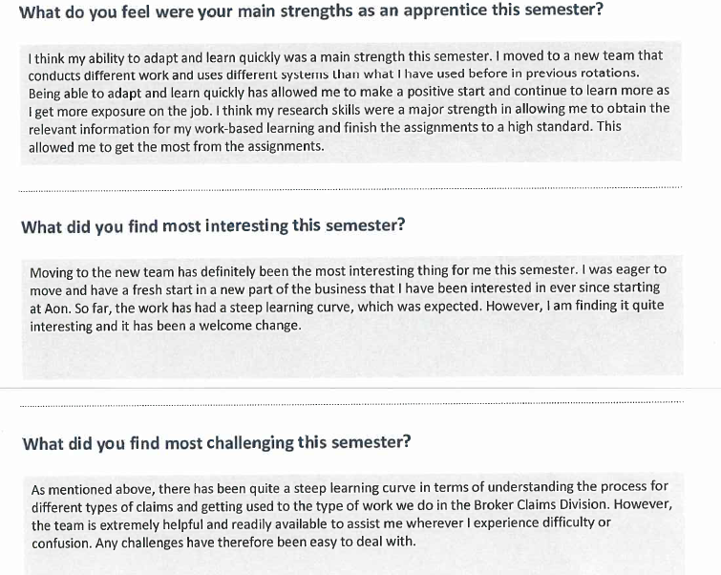

Slide 32
A Supervisor’s Perspective

Slide 33
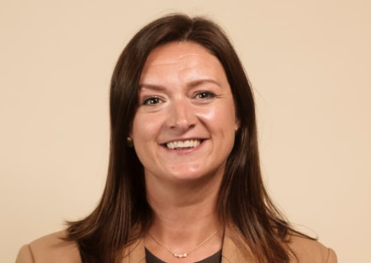
Mary Fitzpatrick, CMCC Financial Solutions

Slide 34
Thank you!
Questions Please

Slide 35
Supervisors’ Resource Centre
An email will be sent with a password after this session for access. The Resource Centre has copies of all relevant documentation
and information relating to the Insurance Practitioner Apprenticeship for both Life & Non Life Supervisors and Mentors. ​
The Resource Centre can be accessed through:
https://earnandlearn.ie/apprenticeships-employers​

